Slide 1

DIGITAL LOGIC DESIGN (111776)
Dr. Owais Hussain

Slide 2
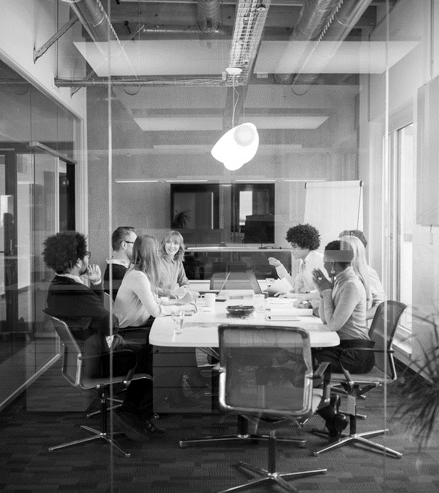
Agenda
Comparators
Decoders
Binary to Decimal Decoder
7-Segment Display Decoder
Encoders

Slide 3
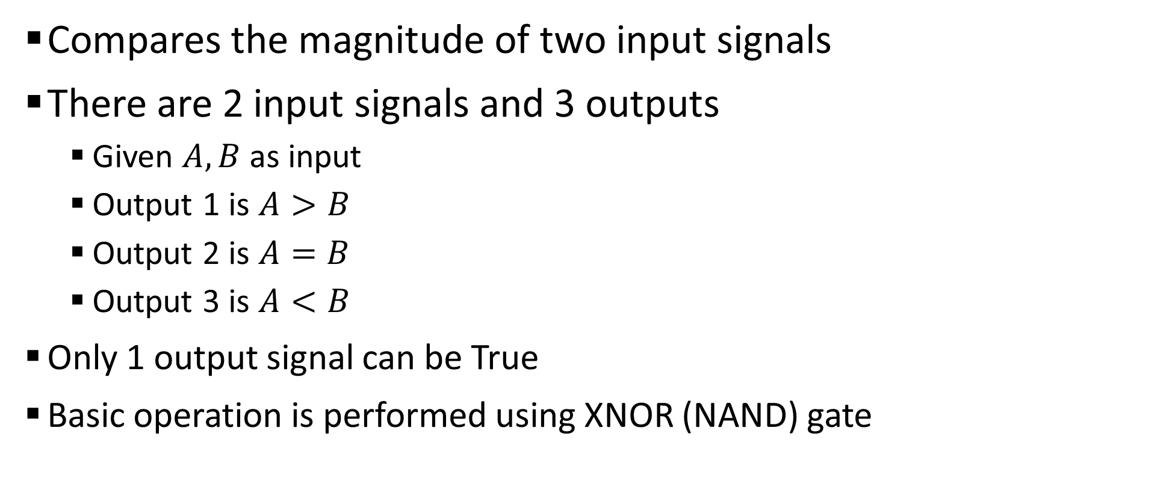
Sample 2
Comparators
Compares the magnitude of two input signals
There are 2 input signals and 3 outputs
Given $A,B$ as input
Output 1 is $A>B$
Output 2 is $A=B$
Output 3 is $A<B$
Only 1 output signal can be True
Basic operation is performed using XNOR (NAND) gate

Slide 4
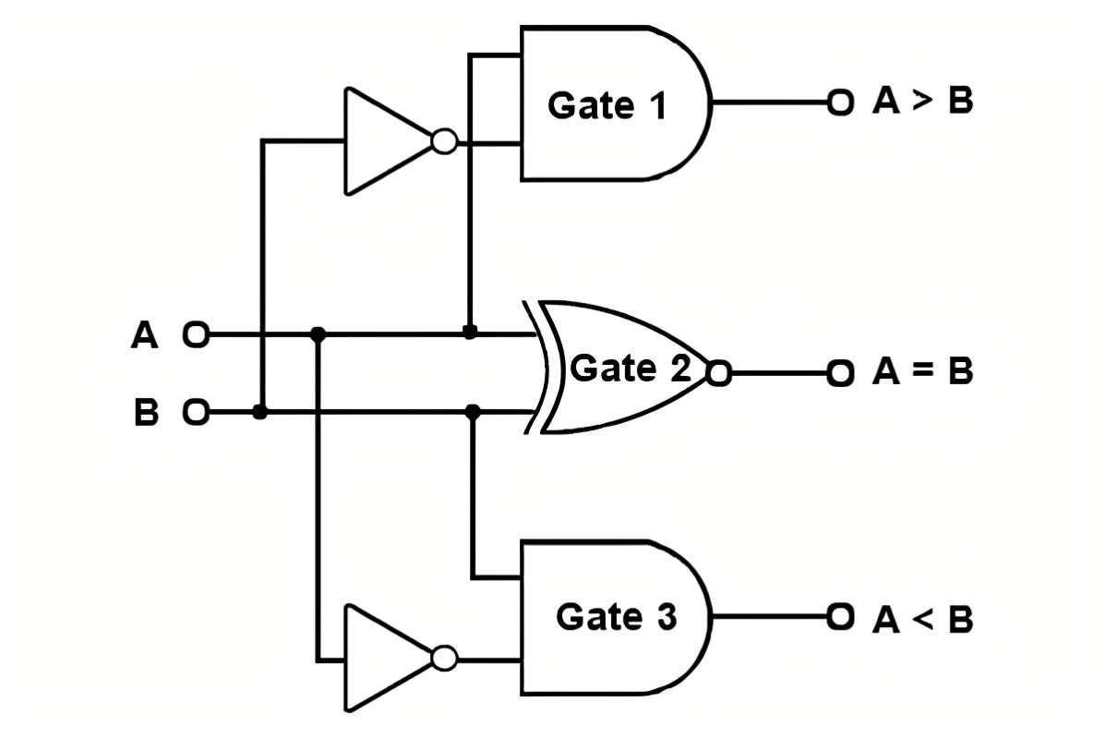
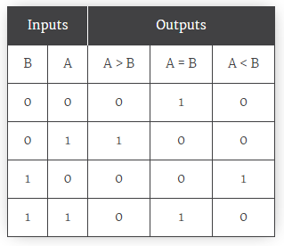
Sample 2
Comparators
1-bit Comparator

Slide 5
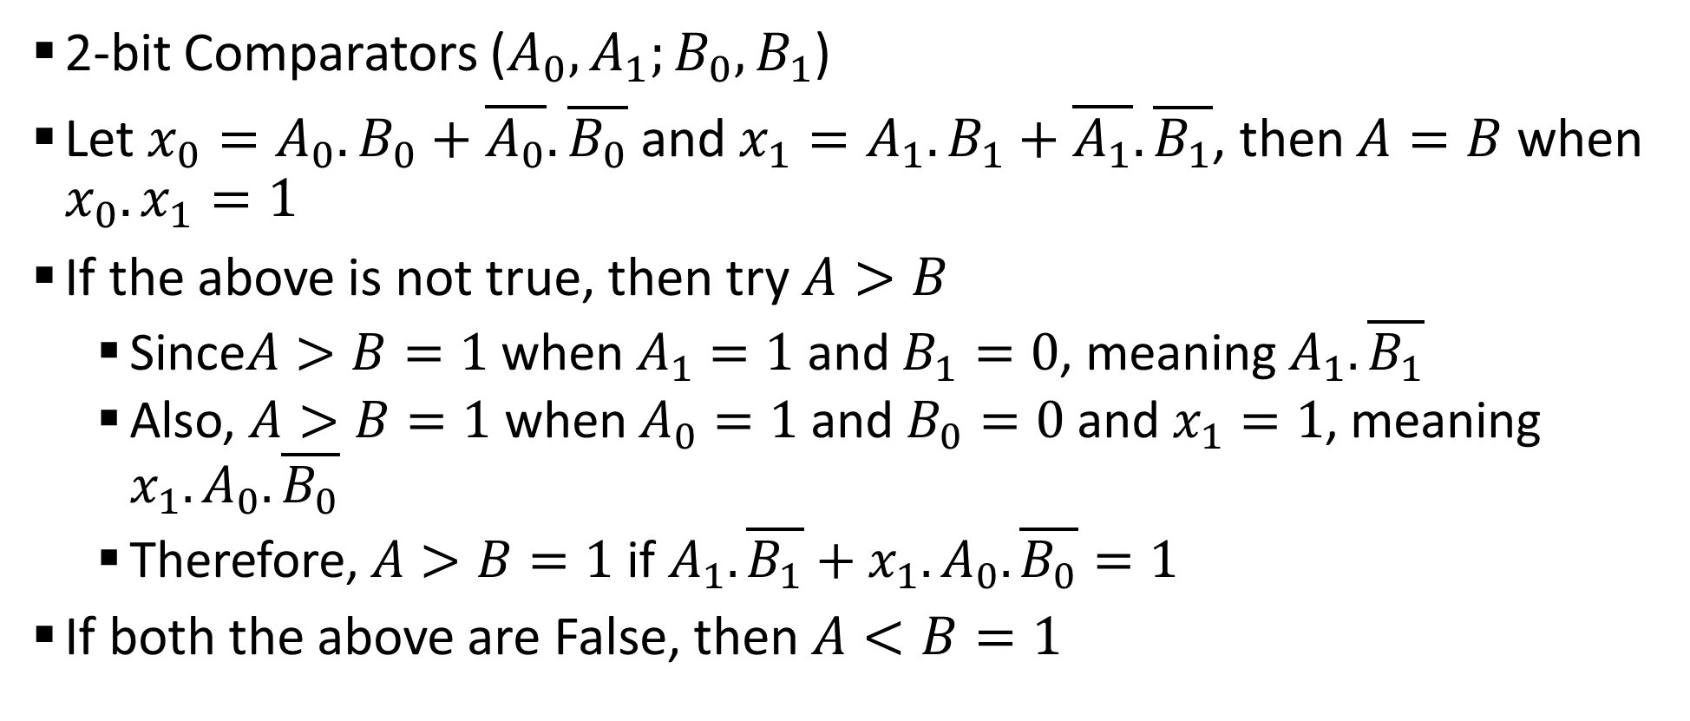
Sample 2
Comparators – n-bit
2-bit Comparators ($A_{0},A_{1};B_{0},B_{1}$)
Let $x_{0}=A_{0}.B_{0}+\overline{A_{0}}.\overline{B_{0}}$ and $x_{1}=A_{1}.B_{1}+\overline{A_{1}}.\overline{B_{1}}$, then $A=B$ when $x_{0}.x_{1}=1$
If the above is not true, then try $A>B$
Since$A>B=1$ when $A_{1}=1$ and $B_{1}=0$, meaning $A_{1}.\overline{B_{1}}$
Also, $A>B=1$ when $A_{0}=1$ and $B_{0}=0$ and $x_{1}=1$, meaning $x_{1}.A_{0}.\overline{B_{0}}$
Therefore, $A>B=1$ if $A_{1}.\overline{B_{1}}+x_{1}.A_{0}.\overline{B_{0}}=1$
If both the above are False, then $A<B=1$

Slide 6
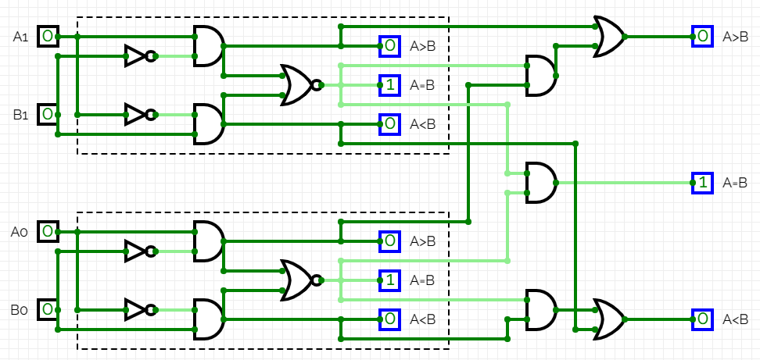
Sample 2
Comparators – n-bit
We can also use a pair of 1-bit Comparators to create a 2-bit comparator.
Notes:
https://circuitverse.org/simulator/edit/2-bit-comparator-5a2a3ff7-a850-490a-9276-873238b5beb5

Slide 7
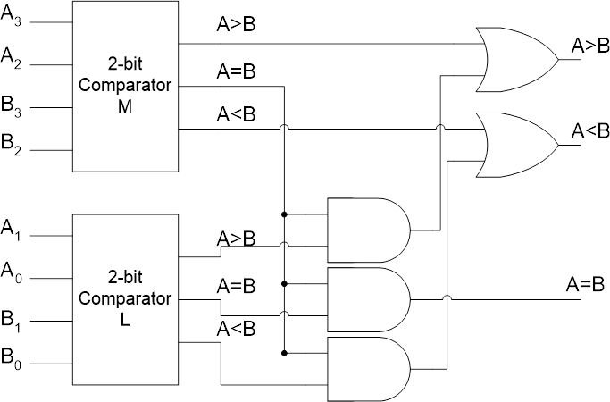
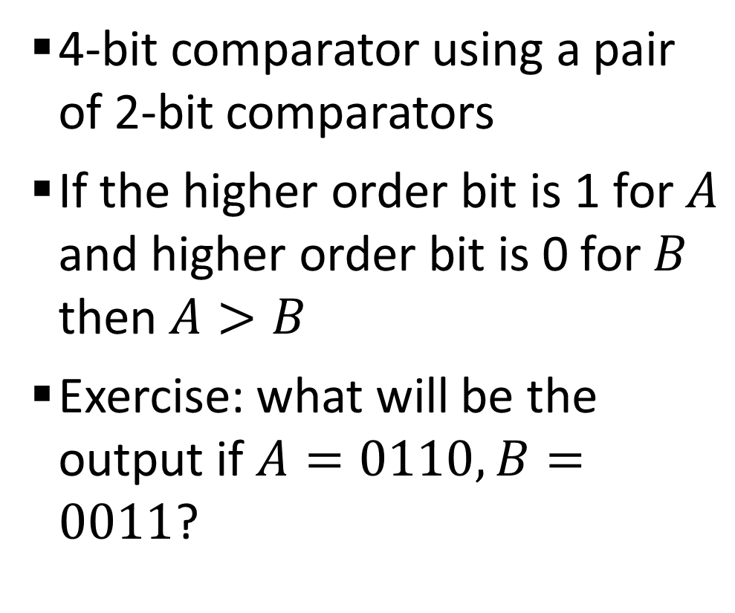
Sample 2
Comparators – n-bit
4-bit comparator using a pair of 2-bit comparators
If the higher order bit is 1 for $A$ and higher order bit is 0 for $B$ then $A>B$
Exercise: what will be the output if $A=0110,B=0011$?

Slide 8
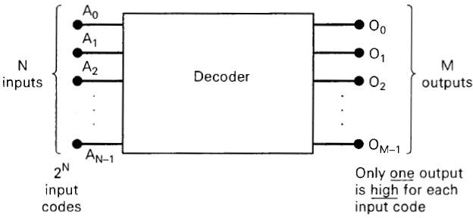
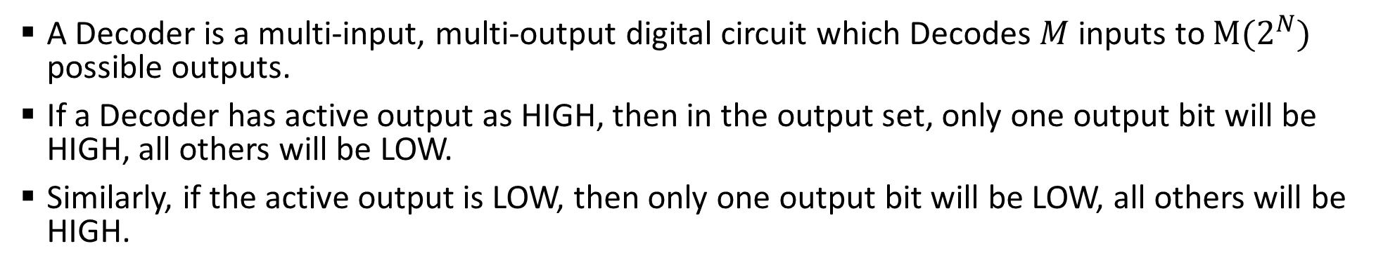
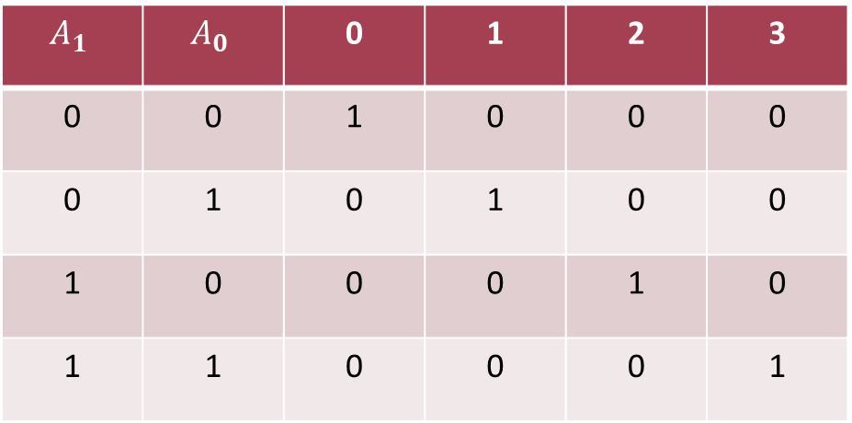
Sample 2
Decoders
A Decoder is a multi-input, multi-output digital circuit which Decodes $M$ inputs to $M(2^{N})$ possible outputs.
If a Decoder has active output as HIGH, then in the output set, only one output bit will be HIGH, all others will be LOW.
Similarly, if the active output is LOW, then only one output bit will be LOW, all others will be HIGH.
$$A_{1}$$ | $$A_{0}$$ | 0 | 1 | 2 | 3
0 | 0 | 1 | 0 | 0 | 0
0 | 1 | 0 | 1 | 0 | 0
1 | 0 | 0 | 0 | 1 | 0
1 | 1 | 0 | 0 | 0 | 1

Slide 9
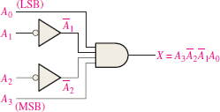
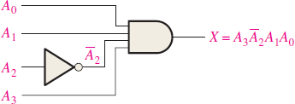
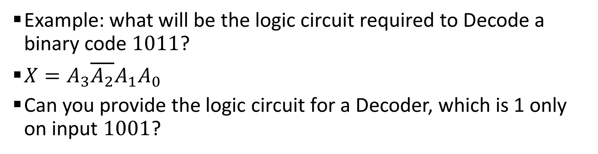
Sample 2
Decoders
Example: what will be the logic circuit required to Decode a binary code $1011$?
$X=A_{3}\overline{A_{2}}A_{1}A_{0}$
Can you provide the logic circuit for a Decoder, which is 1 only on input $1001$?

Slide 10
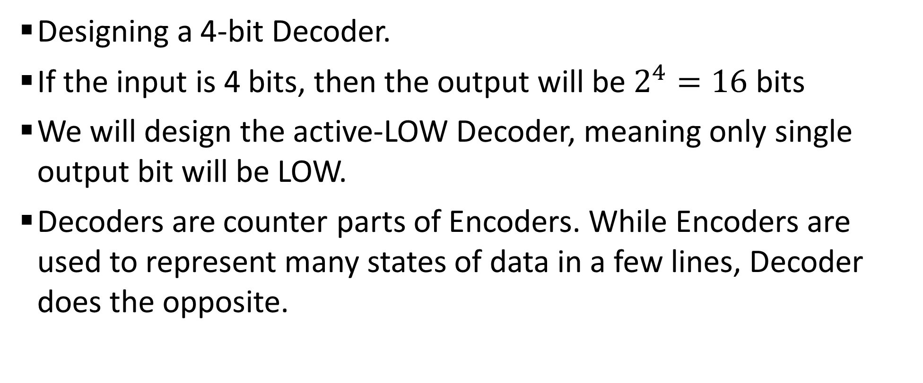
Sample 2
Decoders
Designing a 4-bit Decoder.
If the input is 4 bits, then the output will be $2^{4}=16$ bits
We will design the active-LOW Decoder, meaning only single output bit will be LOW.
Decoders are counter parts of Encoders. While Encoders are used to represent many states of data in a few lines, Decoder does the opposite.

Slide 11
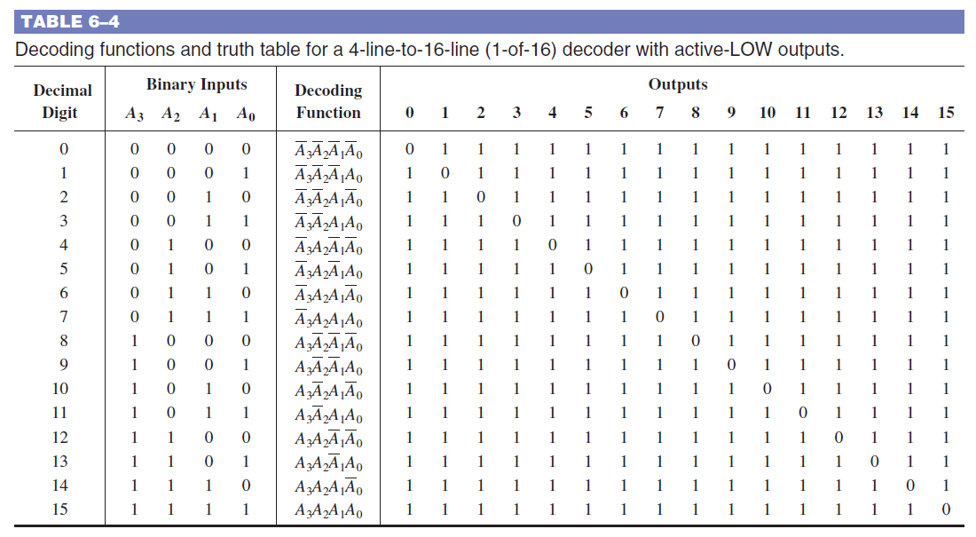
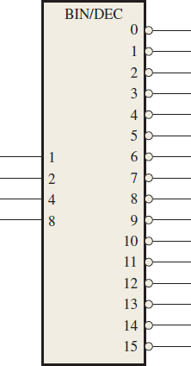
Sample 2
Binary to Decimal Decoder
A 4-bit Binary to Decimal Decoder
0
1
1
1
1
1
1
1
1
1
1
1
1
1
0
0
0
0

Slide 12
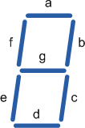
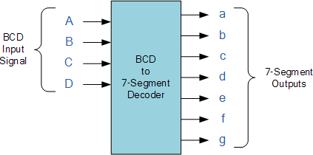

Sample 2
7-Segment Display Decoder
What’s a 7-Segment Display?
How is each number represented?
BCD to 7-Segment Display
How will digit ‘7’ be displayed?

Slide 13
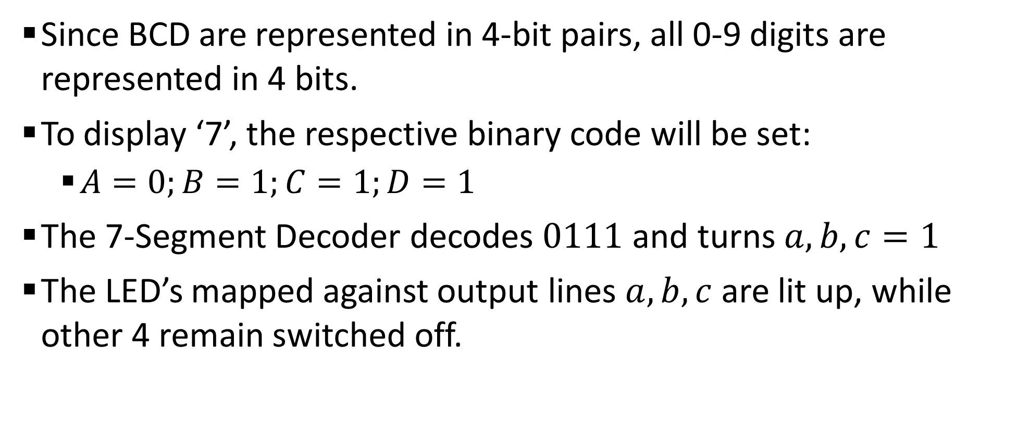
Sample 2
7-Segment Display Decoder
Since BCD are represented in 4-bit pairs, all 0-9 digits are represented in 4 bits.
To display ‘7’, the respective binary code will be set:
$A=0;B=1;C=1;D=1$
The 7-Segment Decoder decodes $0111$ and turns $a,b,c=1$
The LED’s mapped against output lines $a,b,c$ are lit up, while other 4 remain switched off.
Notes:
https://circuitverse.org/simulator/edit/bcd-to-7-segment-decoder-0e272c25-de71-4748-a7dc-2e67fdf15968

Slide 14
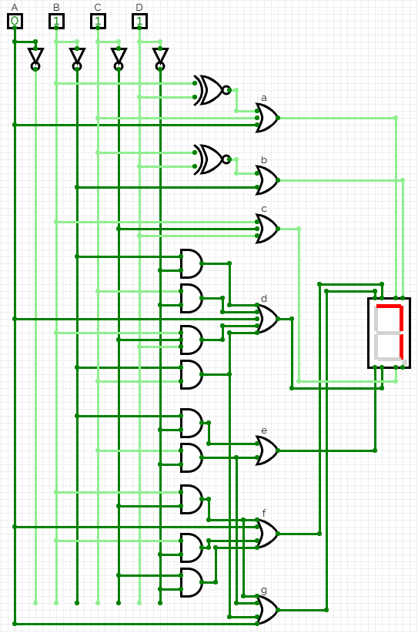
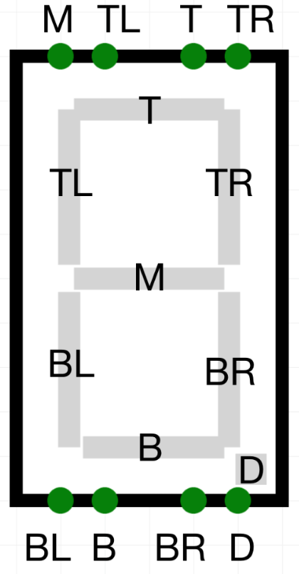
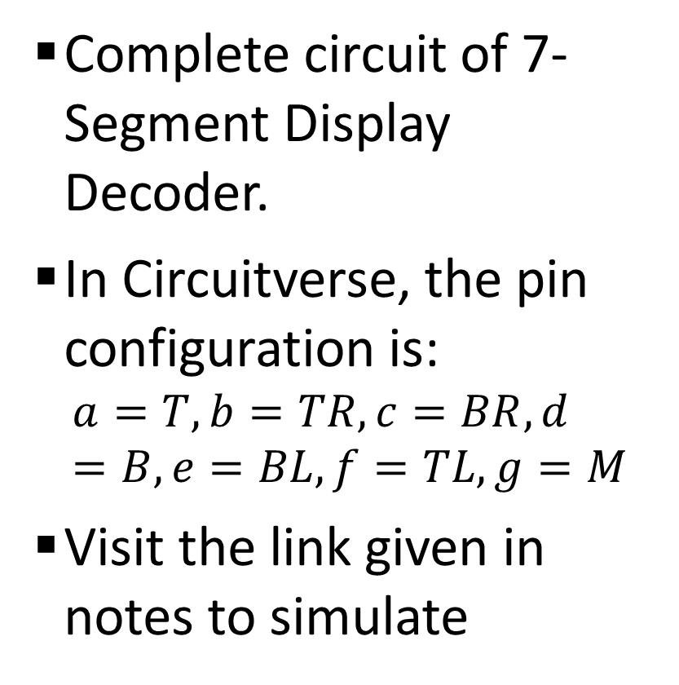
Sample 2
7-Segment Display Decoder
Complete circuit of 7-Segment Display Decoder.
In Circuitverse, the pin configuration is:
$$a=T,b=TR,c=BR,d=B,e=BL,f=TL,g=M$$
Visit the link given in notes to simulate
Notes:
https://circuitverse.org/simulator/edit/bcd-to-7-segment-decoder-0e272c25-de71-4748-a7dc-2e67fdf15968

Slide 15
Sample 2
Revision Activity (optional)
Rules:
You will attempt half of these questions from each chapter, of your own choice.
For each question where there are multiple parts, attempt only one part.
On completion of this activity, you will retain full marks for 2 activities.
Scan each solution separately and submit on LMS
Zero tolerance on Plagiarism.
Chapter 4: Q: 3, 4, 5, 8, 11, 13, 14, 15, 19, 21, 24, 29, 32, 36, 39, 41, 44, 50
Chapter 5: Q: 2, 3, 14, 15, 20, 22, 23, 29, 30, 31
Chapter 6: 2, 3, 4, 6, 13, 14

Slide 16



THANK YOU
Owais Hussain
+92 345-3174270
owais.hussain@kiet.edu.pk
https://www.researchgate.net/profile/Owais-Hussain-3

